Slide 1
CLASSROOM RULES
Be on time
Be interactive
100% or nothing
Do all daily challenges

Slide 2
Lesson 16
ADVERBS
Brought to you by LangGo

Slide 3
REVIEW
GRAMMAR + VOCABULARY

Slide 4
REVIEW: LISTENING
I went to a new steak restaurant last night that opened near my house.
To start the meal, I had an interesting appetizer.
It was nice and fresh with a great house dressing.
The vegetables were good—very fresh and tasty.
My new girlfriend took me to a Chinese restaurant in her neighborhood the other night.
For my main dish, I had a piece of pork. It was too dry and had no taste.
They were the best I had ever tasted.
The dessert was a big bowl of fresh fruit.

Slide 5
REVIEW: SPEAKING
Work in pairs.
Practice asking and answering these questions from the topics you have learnt.
https://docs.google.com/document/d/1aRzHgnWGVEDrdvXGo7AO-F9QexwYieKcxK1s7Khqtkw/edit?usp=sharing

Slide 6
OBJECTIVES
Identify adverbs in sentences.
Understand the function and usage of Adverbs.
Distinguish different types of Adverbs.

Slide 7
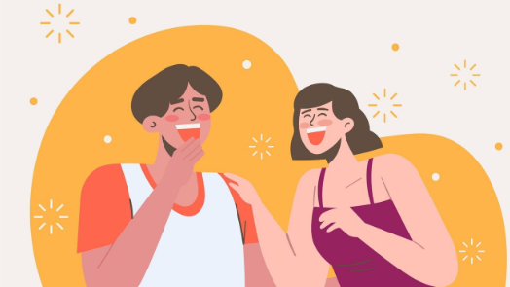
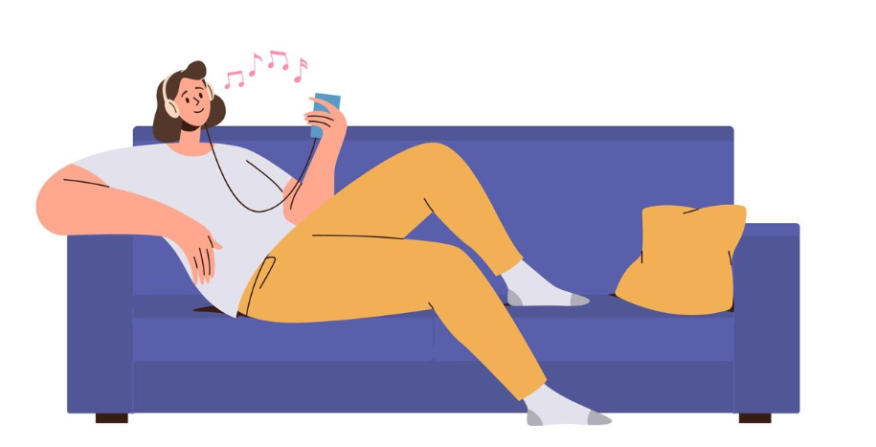
Definition
They laughed loudly.
She is listening to music happily .
Definition: An adverb is a word that describes a verb. It tells you about an action, or the way something is done.

Slide 8
DIVISION
Manner
Frequency
Time
ADVERB
Degree
Place

Slide 9
Manner
She smiles warmly at everyone.
He works quickly.
Definition: Adverbs of Manners describe the way something is done.
Form: Adv = Adj + ly
Position: after a Verb.

Slide 10
Manner
She smiles warmly at everyone.
Make 4 similar sentences about people you know:
(Ms Hoa) speaks English fluently because she practices every day.
(My sister) always sings loudly when she takes a shower.
(My friend) listens carefully when someone is speaking.
Hung laughs easily at every little joke.
He works quickly.
Definition: Adverbs of Manners describe the way something is done.
Form: Adv = Adj + ly
Position: after a Verb.

Slide 11
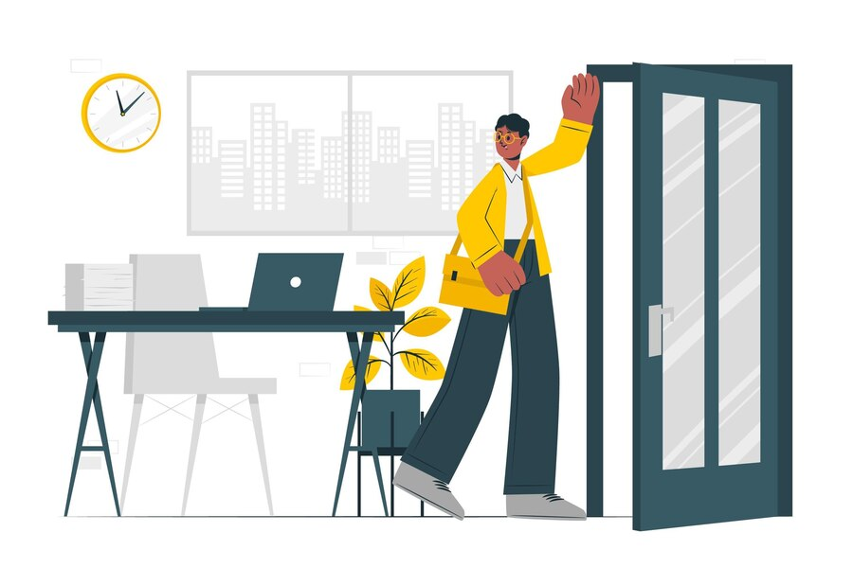
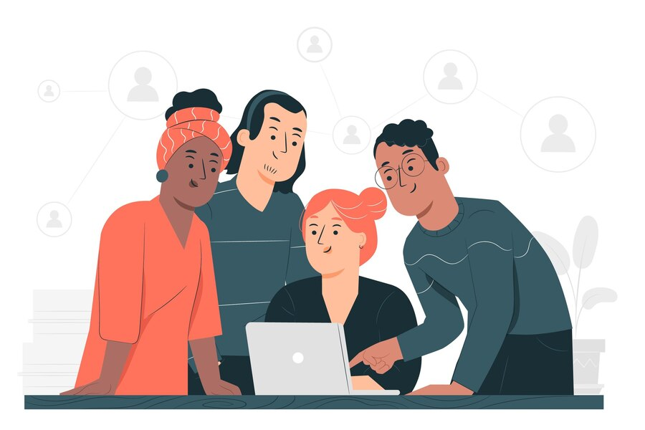

Time
He will go home later.
They have just finished work.
Definition: Adverbs of Time describe when something happens.
Example: yesterday, today, last night, after, before, yet, soon, lately, recently,…
Position: at the end/beginning of a sentence; between a verb and an auxiliary verb

Slide 12
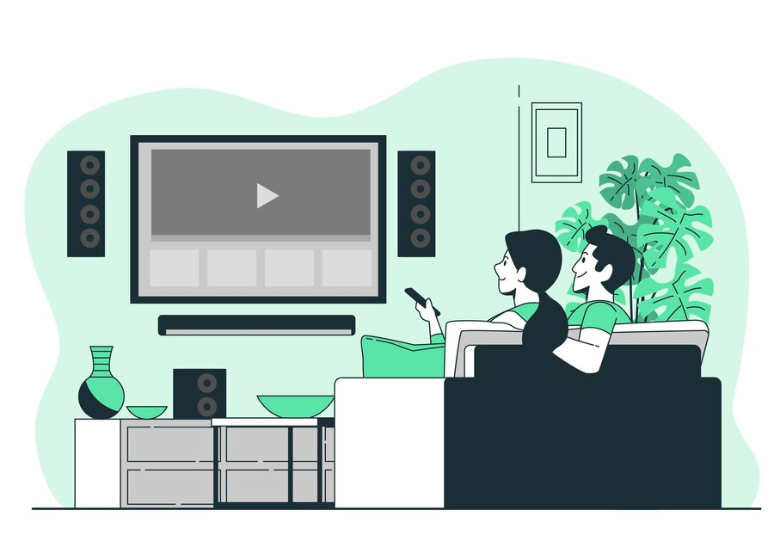
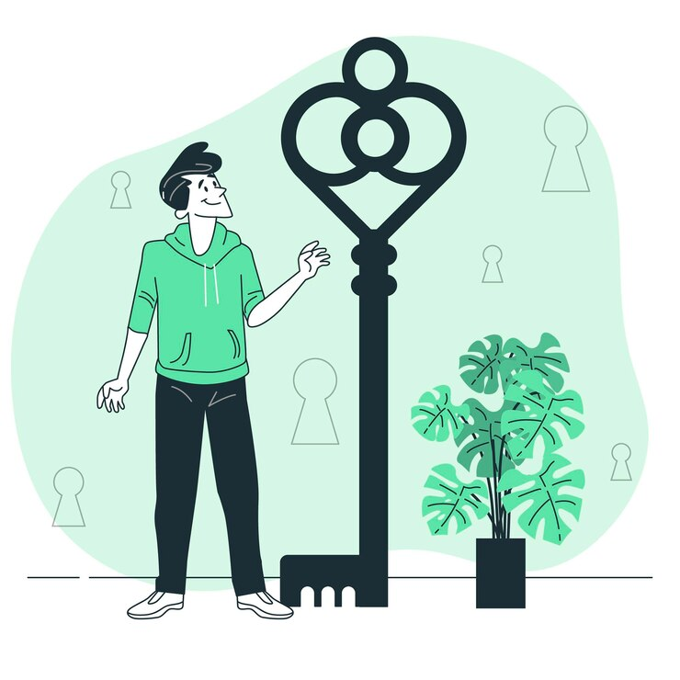
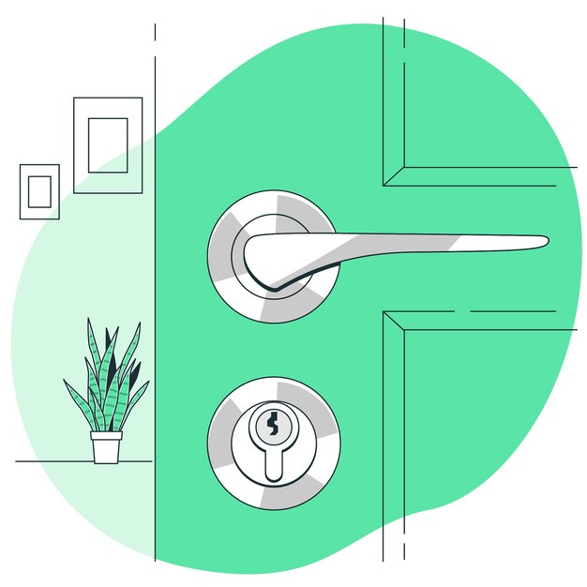
Place
Mom and Dad often watch TV upstairs.
Here, I found the missing keys.
Definition: Adverbs of Place describe where something happens.
Example: here, there, nowhere, everywhere, out, above, below,…
Position: at the end/beginning of a sentence
Note: We don't use prepositions before adverbs of place:
in here; go to there

Slide 13
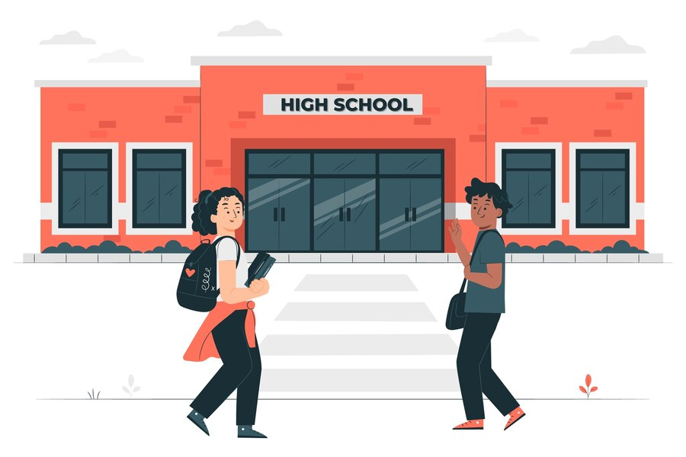
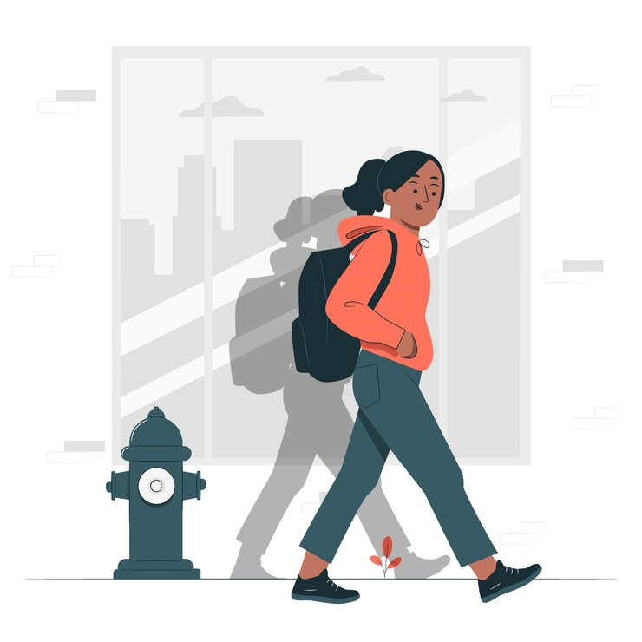
Frequency
I always go to school on time.
I don’t usually go home late.
Definition: Adverbs of Frequency describe how often something happens.
Example: always, never, often, usually, sometimes, seldom,…
Position: between a noun and a verb; between a verb and an auxiliary verb

Slide 14
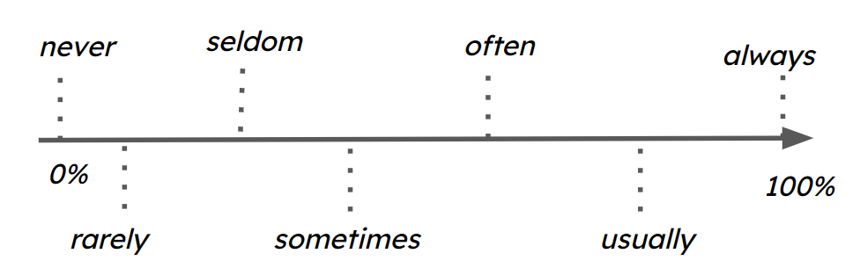
Frequency

Slide 15
True or False?
Work with a partner.
Read each sentence out loud.
Your partner will guess if it is true or false about you.
If it’s false, correct the sentence using a more suitable adverb.

Slide 16
True or False?
1
2
3
4
5
I sometimes watch English movies to improve my listening skills.
I rarely eat fast food because I try to stay healthy.
I never use my phone during meals.
My best friend and I always hang out on Saturdays.
I usually spend at least two hours a day studying English.

Slide 17
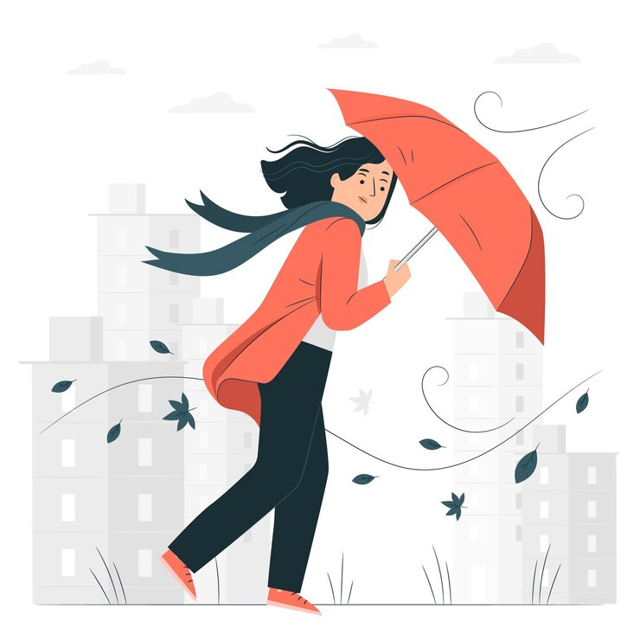
Degree
It’s too windy outside.
Definition: Adverbs of Degree describe the intensity of an action, an adjective or another adverb.
Example: too, enough, a lot, a little bit, quite,...
Position: before or after an adjective or an adverb.

Slide 18
Adjectives vs. adverbs
My family
I have a happy / happily family. My parents always smile and talk kind / kindly to each other. My father is a quiet / quietly man, but he speaks clear / clearly when he gives advice. He loves fishing, so we go fishing together on the weekend. My mother cooks good / well, she makes us dinner every night. And she is a very good / well artist, too. My mom taught me how to paint a beautiful/beautifully picture. My brother is very funny / funnily, and he always tells jokes at dinner. He always makes me laugh loud/loudly over his jokes. Even when we are busy, we eat together and share how our days went with each other. I feel lucky / luckily to have such a great family.

Slide 19
REVIEW SPEAKING QUESTIONS
WEEKEND
1. What do you often do in your free time?
2. What do you often do on the weekend?
3. Do you like sports? How often?
4. Do you like watching movies?
What kinds of movies do you like? What is your favorite movie?
5. Do you like reading books?
FAMILY
1. Do you live in a big family?
2. What does he/she look like?
6. What is he/she like?

Slide 20
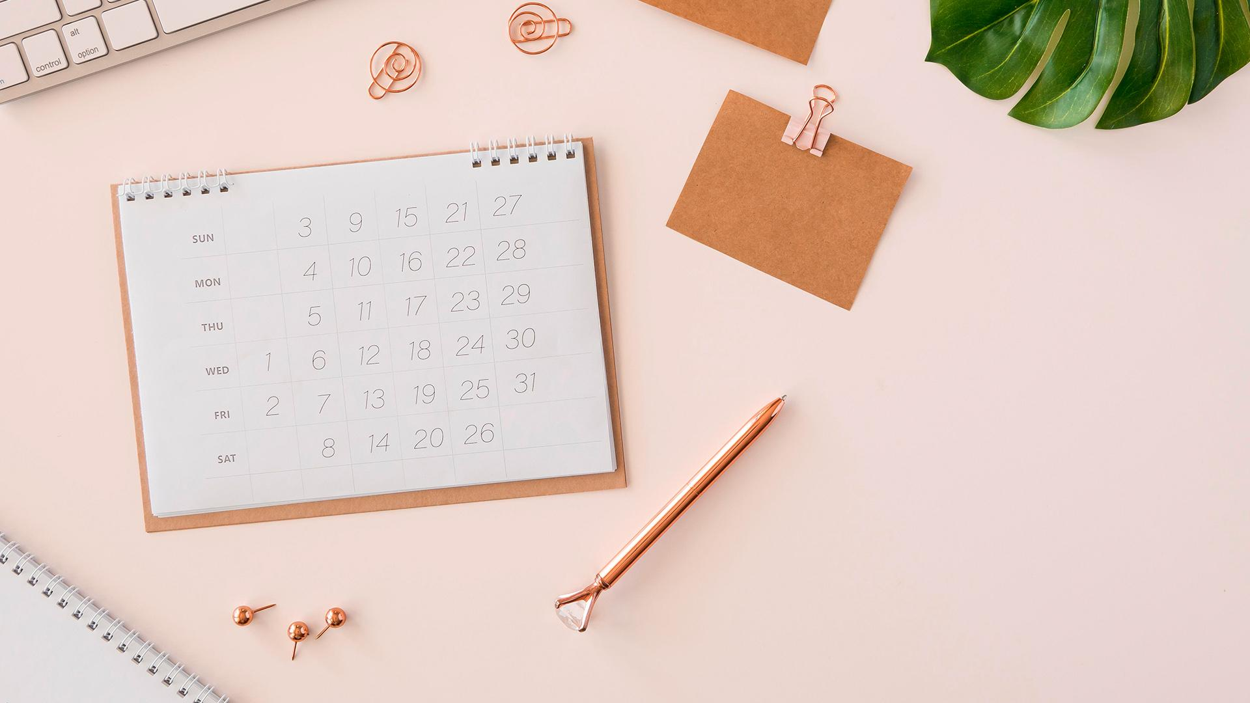

GOODBYE
See you later!

